Slide 1
Credit Risk Prediction
Noudika Aura Lubis

Slide 2
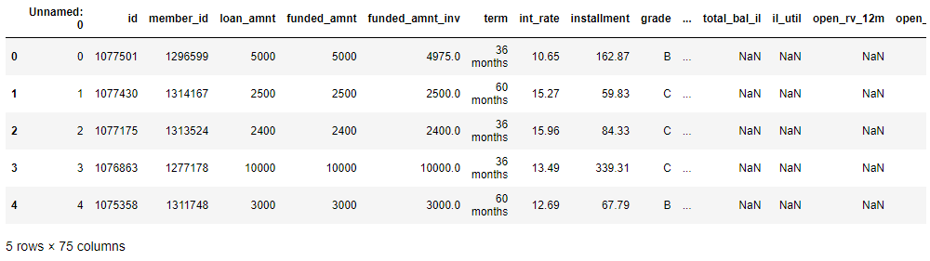
Load Data
The dataset contains 466285 rows and 75 columns.

Slide 3
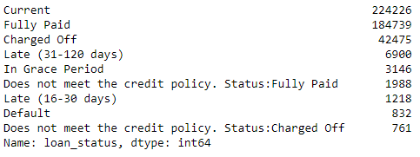
Define Target Variable
Target Variable is the feature of a dataset about which we want to gain a deeper understanding and learn patterns between the dataset.
In this dataset, we can use the loan_status column to see the ending of each loans.

Slide 4
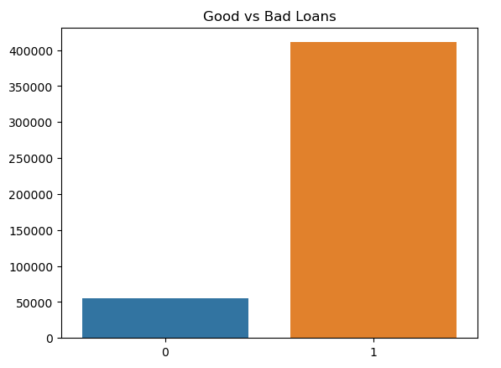
Classify Variables
This classification depends on the regulations of the lending company
The comparison between good and bad loans:

Slide 5
Feature Engineering & Feature Selection
Check the dataset for missing values, duplicate, inconsistent columns and etc.
Drop identities columns (which have each unique values but irrelevant)
Drop columns that contain >50% missing values.
Drop columns that only have 1 unique values.
Drop columns that contain data leakage.
Drop columns that have similar values (Check the correlation).

Slide 6
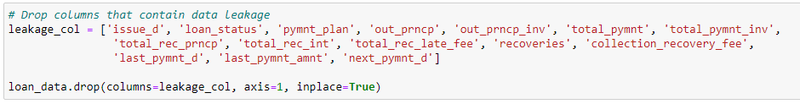
Data Leakage
One of the common pitfalls when building a machine learning model is Data Leakage.
In this dataset the example of target leakage is 'out_prncp', when'out_prncp' column has 0 value, it means the loan is already fully paid. The result of this column will be super accurate because it's already happened, the loan is already paid, but this data is not relevant to predict a new borrower so it will be unfair. This kind of variable will create overly optimistic models that are practically useless and cannot be used in production.
Hence, the columns that contain Data Leakage will be drop.

Slide 7
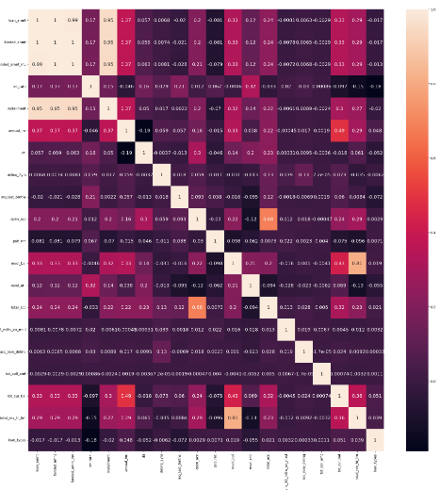
Check correlation
From this heatmap, we can see the columns that are similar with each other.
We can remove 2 out of 3 similar columns.

Slide 8
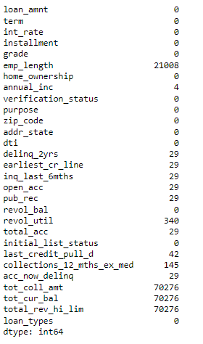
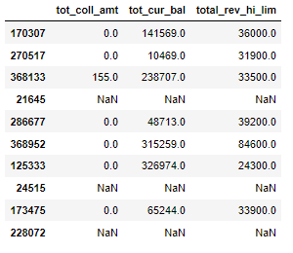
Check the Missing Values
From this we can see that 'tot_coll_amt', 'tot_cur_bal', 'total_rev_hi_lim’ have similar number of missing values.

Slide 9
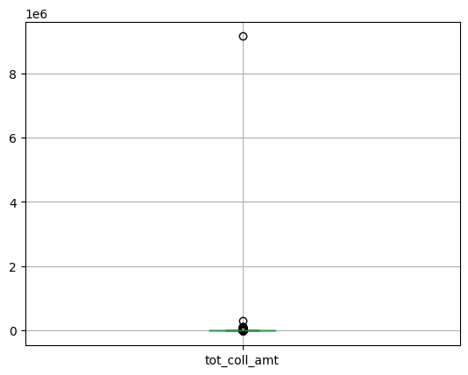
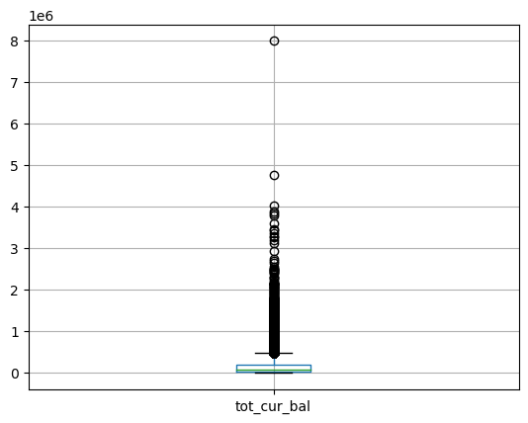
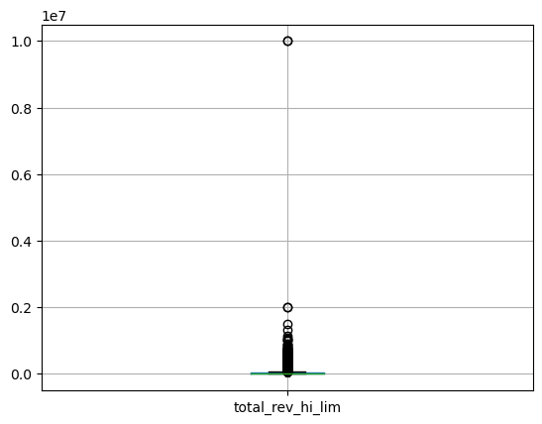
Conclusion:
The description of these columns are rather vague
Total missing value is 70276
The rows that contain missing values in those columns will be dropped

Slide 10
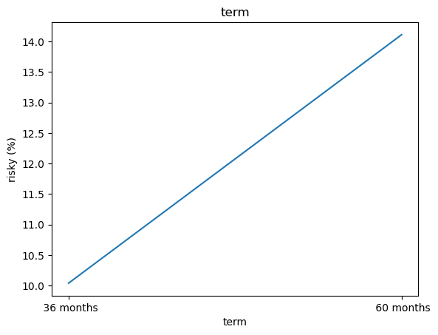
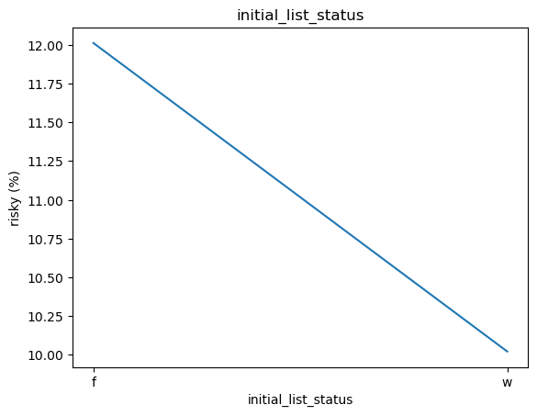
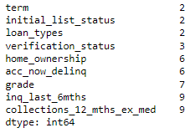
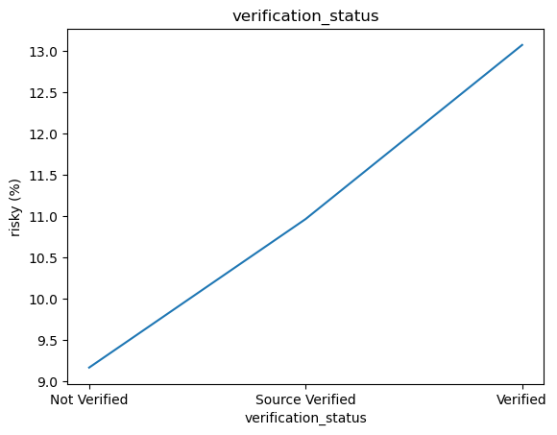
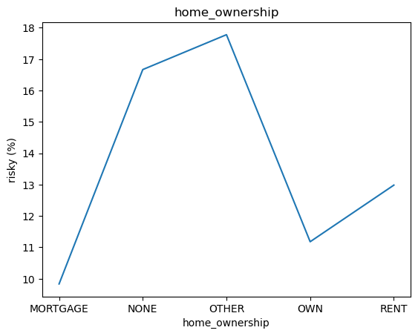
Explore data with less than 10 unique values.

Slide 11
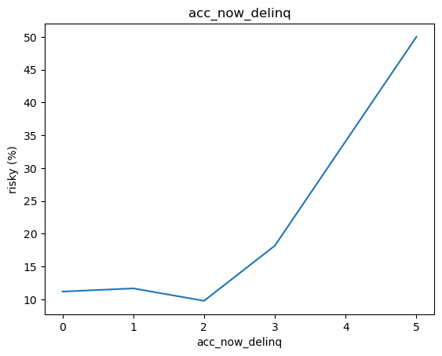
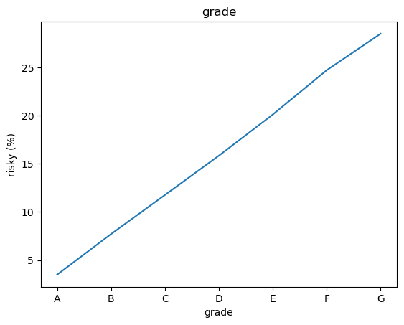
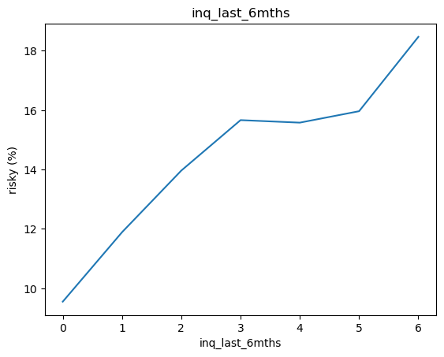
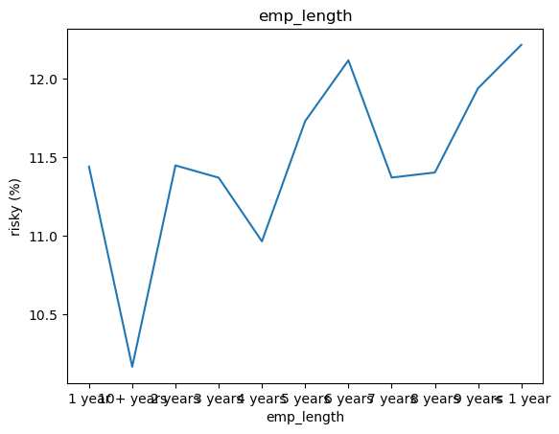

Slide 12
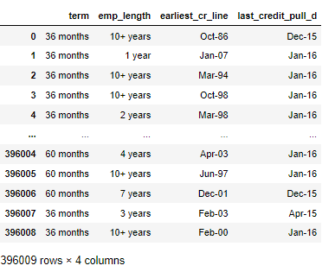
Check columns data type
The following columns should be modified because they don't have appropriate data types.

Slide 13
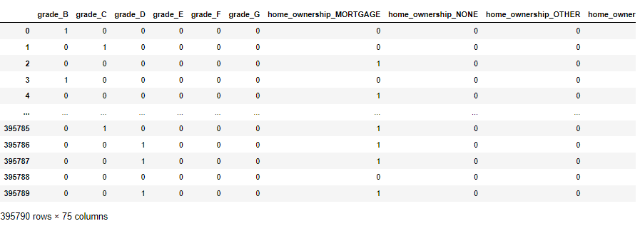
One Hot Encoding
One hot encoding is a technique that we use to represent categorical variables as numerical values in a machine learning model. This technique can improve model performance by providing more information to the model about the categorical variable.

Slide 14
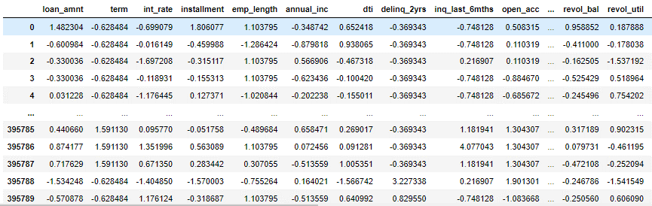
Standardization
Standardization entails scaling data to fit a standard normal distribution.
A standard normal distribution is defined as a distribution with a mean of 0 and a standard deviation of 1

Slide 15
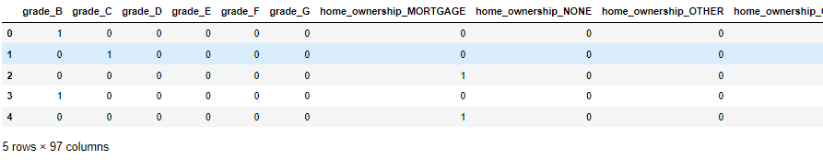
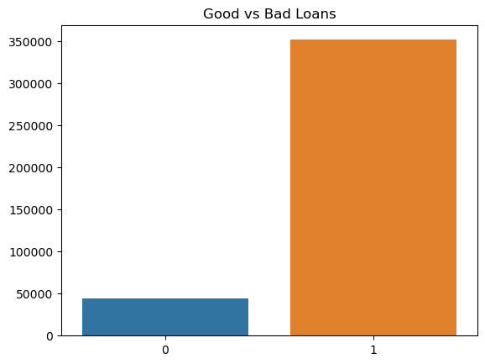
Get Final Data
Check class imbalance with final data

Slide 16
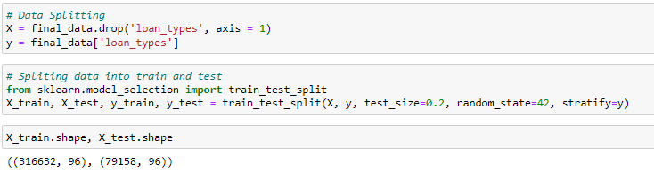
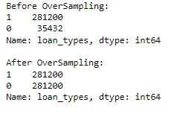
Data Splitting
We can split the data to easily evaluate the performance of our model. Such as, if it performs well with the training data, but does not perform well with the test dataset, then it is estimated that the model may be overfitted
Oversampling Minority Class to Resolve Class Imbalance

Slide 17
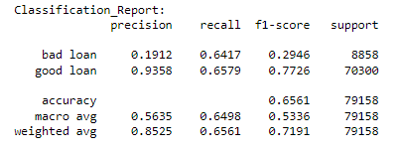
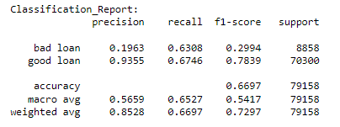
Train the Model
Logistic Regression
Random Forest

Slide 18
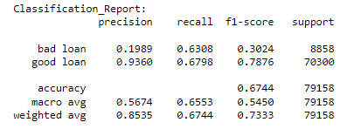
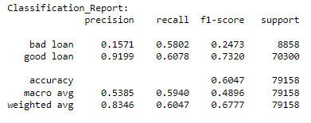
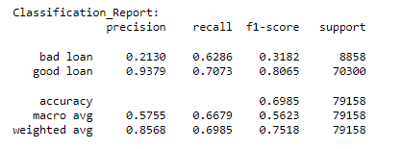
Decision Tree
K-Nearest Neighbors
XGBoost

Slide 19
Conclusion
In the classification report, accurancy is not a good measure of performance, because this is only accurate if the model is balanced. It will give inaccurate results if there is a class imbalance.
After oversampling data and training model, the best results among all models for this credit risk prediction is:
XGBoost (Bad loan recall = 63%, Good loan recall = 70%, Bad loan Precision = 21%, Good loan Precision = 93%) that concludes:
- Out of the actual bad loans, the model correctly predicted this for 63%.
- Out of the actual good loans the model correctly predicted this for 70%.
- Out of the good loans that the model predicted, 93% actually did.
Random Forest (Bad loan recall = 64%, Good loan recall = 67%, Bad loan Precision = 19%, Good loan Precision = 93% that concludes:
- Out of the actual bad loans, the model correctly predicted this for 64%.
- Out of the actual good loans the model correctly predicted this for 67%.
- Out of the good loans that the model predicted, 93% actually did.

